Slide 1

ST. Vincent Pallotti College of Engineering and Technology
DEPARTMENT OF INFORMATION TECHNOLOGY
Academic Year 2019-20
Introductory Seminar on
TO AUTOMATE COMPARISON OF TREES GENERATED FROM NATURAL LANGUAGE USING PARSER
Name of Industry: IIIT Hyderabad
Industry Mentor: Dr.Soma Paul
Project Guide:Pooja walke
Project Member:
GAURAV BHISIKAR
ADITYA DALE
SAGAR MALIK

Slide 2
INTRODUCTION
COMMUNICATOR TOOL is a multilingual language tool on which natural languages are get converted into another foreign languages.
Communicator tool allows the user to see the translation in multiple languages.
In the process of translating one language to another communicator tool generate sentence tree which is now compared manually.
So, In this project we have automated the process of comparison of trees.

Slide 3
What is Sentence Tree?
In a tree diagram, a sentence is divided into two parts: a subject and a predicate. They are made up of noun phrases or verb phrases. These are groups of words that include a noun or verb and any words that add as modifiers. The subject is a noun phrase while a predicate is usually a verb phrase. To generate a sentence tree we need USR(Universal Semantic Representation) .csv
This USR csv is feed into parser to get a conll file which we will be using to generate tree

Slide 4
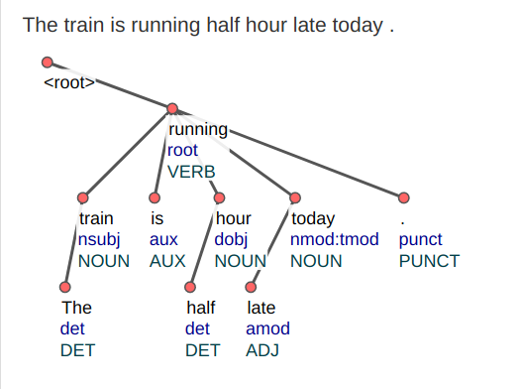

Slide 5
USER_CSV
User_csv is a comma separated value created in excel sheet.
For creating user_csv following 9 should should be important.
GROUPING .
CONCEPT DICTIONARY.
INDEXING.
ONTOLOGICAL INFORMATION.
MORPHOLOGY.
INTRA CHUNK.
INTER CHUNK.
DISCOURSE RELATION.
TYPE OF SENTENCE.

Slide 6
PARSER
A parser is a compiler or interpreter component that breaks data into smaller elements for easy translation into another language. A parser takes input in the form of a sequence of tokens or program instructions and usually builds a data structure in the form of a parse tree or an abstract syntax tree.
Parsing is an important pre-processing step for many NLP applications and therefore of considerable practical interest.

Slide 7
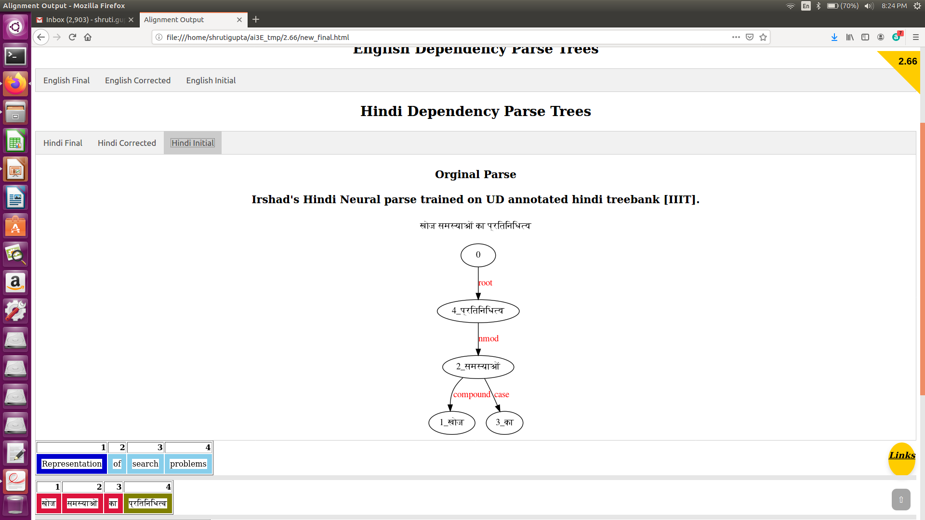
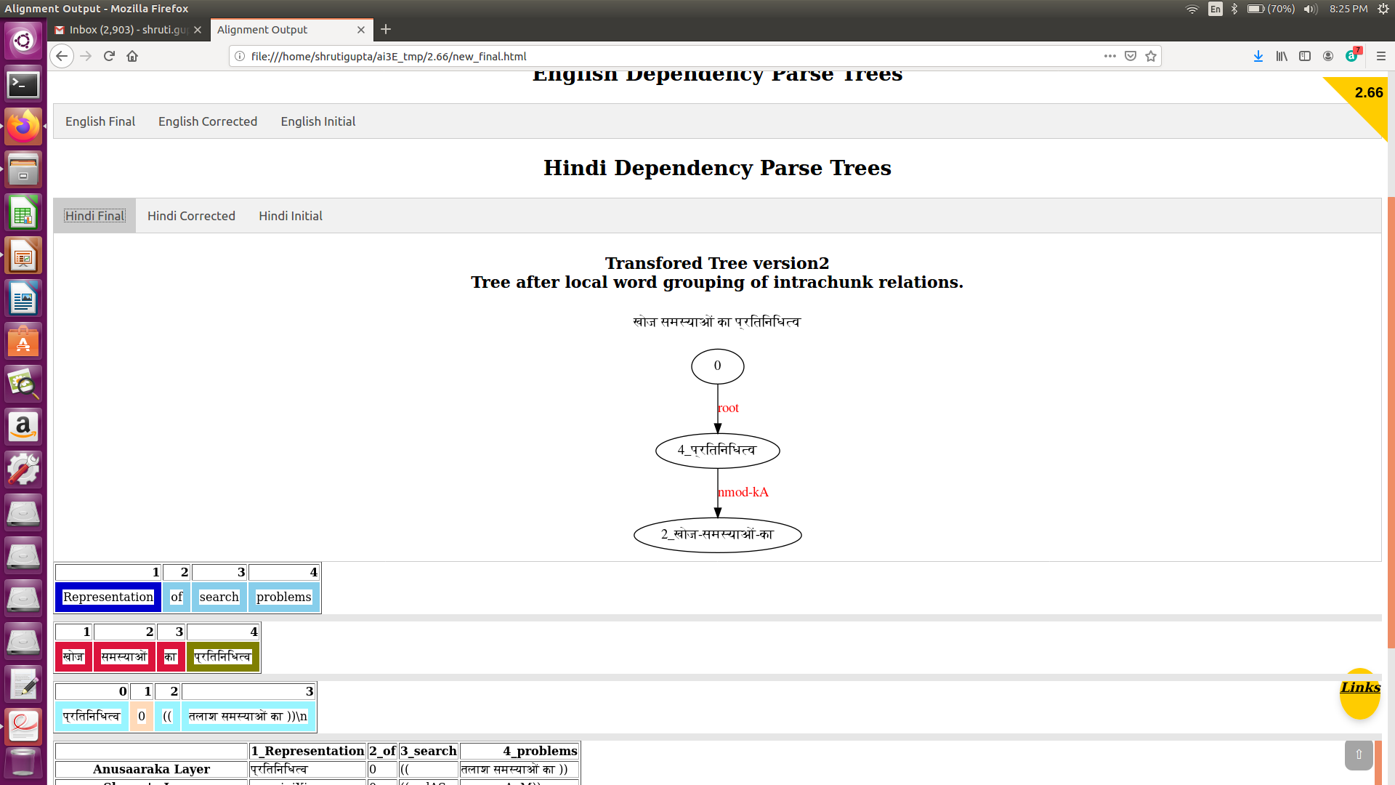
IRSHAD PARSER(HINDI PARSER)

Slide 8
STANFORD PARSER(ENGLISH PARSER)
A natural language parser is a program that works out the grammatical structure of sentences, for instance, which groups of words go together (as "phrases") and which words are the subject or object of a verb.

Slide 9
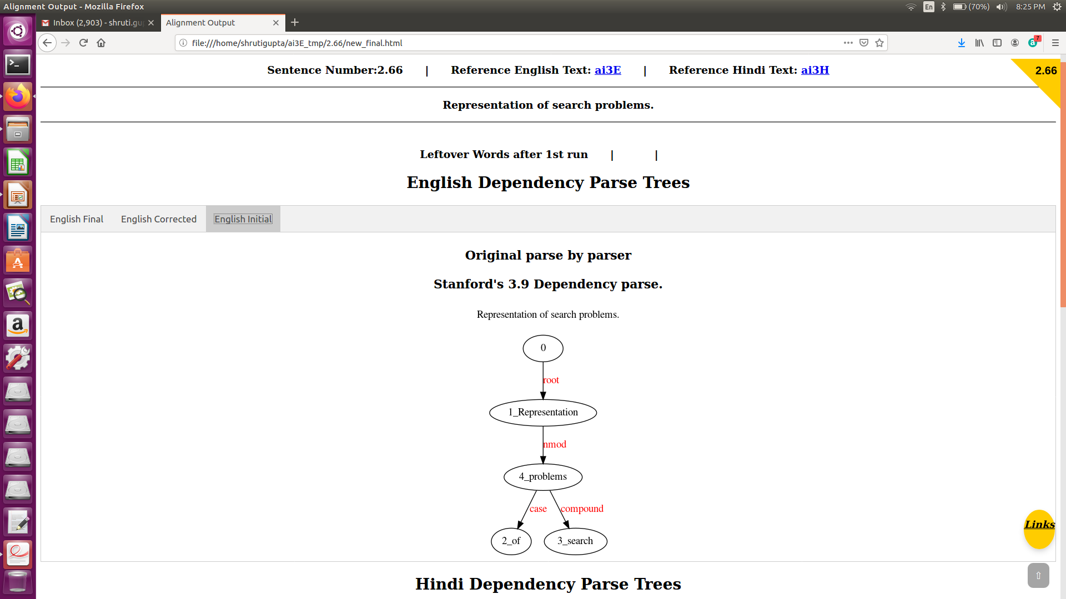
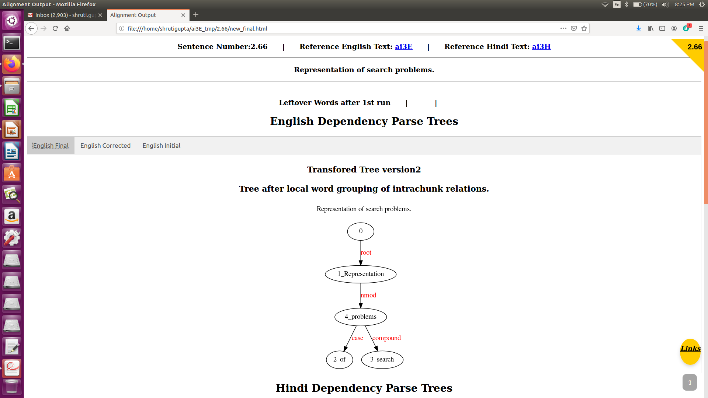
STANFORD PARSER(ENGLISH PARSER)

Slide 10
WX Notation
WX notation is a transliteration scheme for representing Indian languages in ASCII.
It is used for computational processing of Indian languages, and is widely used among the natural language processing (NLP)

Slide 11
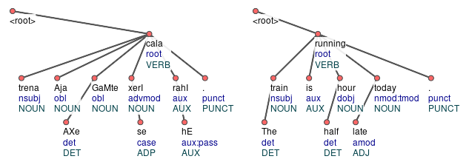
TREE COMPARISON

Slide 12
CONLL FORMAT
The "CONLL" file type represents a corpus with one word per line, each word containing 10 tab-separated columns with information about the word (surface, lemma, POS, syntax...).

Slide 13
CONLL Format Contains 10 Columns:
Column 1: "ID": Word index (starts at 1).
Column 2: "FORM": Surface form of the word.
Column 3: "LEMMA": Lemmatized form of the word.
Column 4: "CPOSTAG": Coarse-grained POS-tag
Column 5: "POSTAG": Fine-grained POS-tag.
Column 6: "FEATS": Set of features
Column 7: "HEAD": Head of the current token for dependency relation.
Column 8: "DEPREL": The dependency relation.
Column 9: "PHEAD": Projective head
Column 10: "PDEPREL": The dependency relation for PHEAD

Slide 14
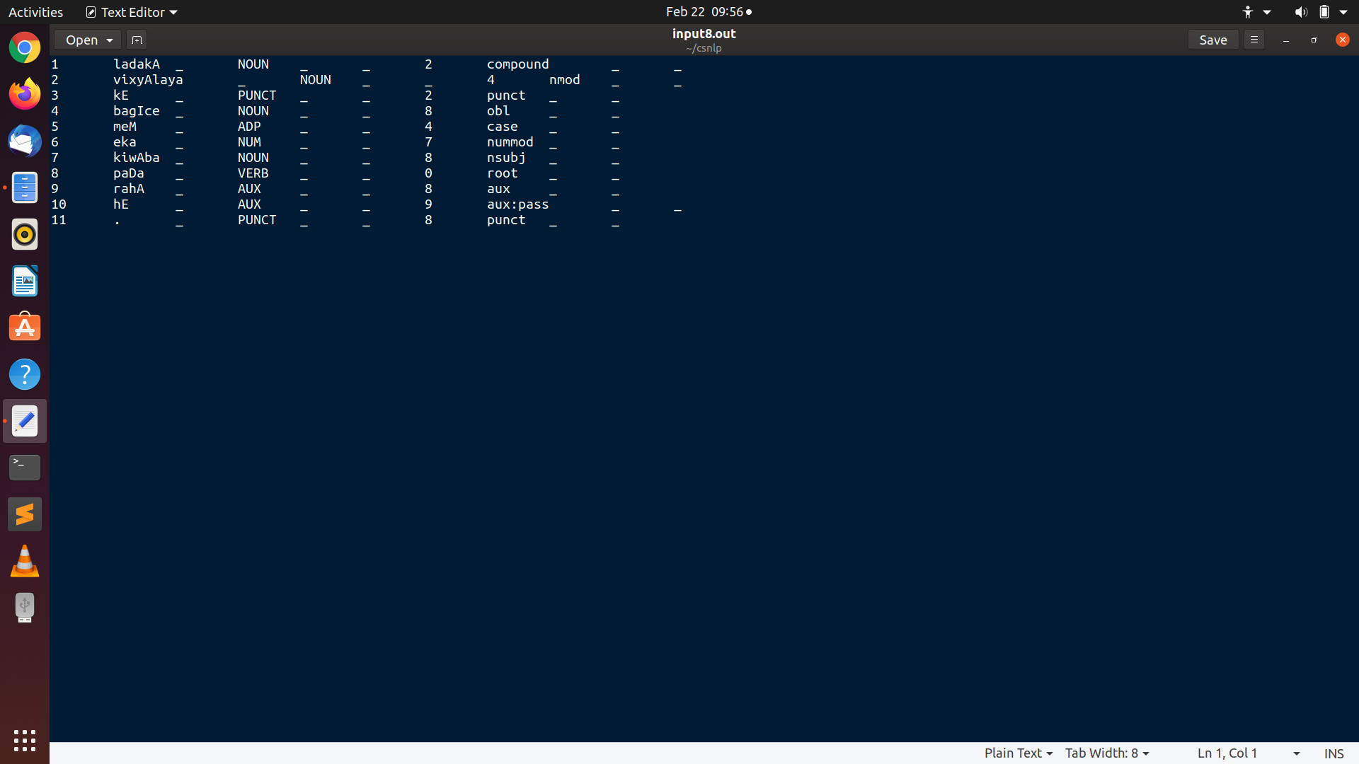
CONLL FORMAT

Slide 15
REFERENCES
[1] Sriram Chaudhary, “Anusaaraka: An Expert System based MT System”, in the proceeding of IEEE conference on Natural language processing and knowledge management, Published 2010.
[2] Akshar Bharati, “Anusaaraka: Overcoming the Language Barrier in India”, appeared in “Anuvad”, Published: New Delhi, 2002.
[3] Naskar S. and Bandyopadhyay S. “Use of machine translation in India: status machine translation Review 15, Published: Dc 2005.”

